Slide 1
Chapter 0: Why Software Architecture?
Pingjian Zhang
School of Software Engineering, SCUT
2018

Slide 2

Syllabus
Textbook
Grading Policy
Attendance: 20%
Projects: 20%
Final: 60%

Slide 3
Chapter Outline
Large, complicated software systems need architectures
A short history of architectures
System qualities are determined by architectures
Architectures facilitates communications among stakeholders

Slide 4

Small Programs
Notes:
单模块程序

Slide 5

Medium-size Programs
Notes:
多模块交互

Slide 6
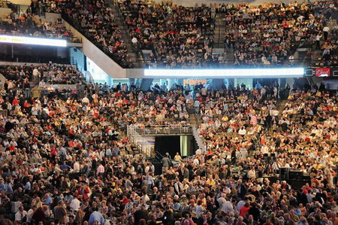
Large-scale Systems
Notes:
外部系统交互

Slide 7
Large, complicated software systems need architectures
Degree of abstraction becomes more and more greater
program=data structure+algorithm
program=object+object
system=component+component
system=service+service
system=element+connector
Overall structure > technical details
Qualities > functionalities

Slide 8
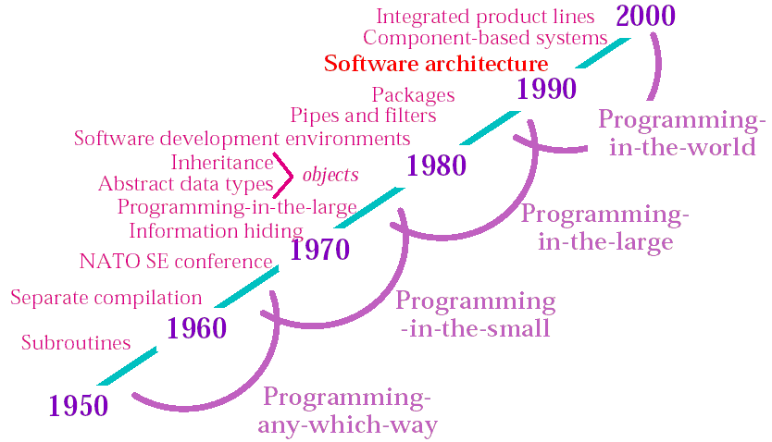
Development of Software Engineering

Slide 9
Formation of SA
Research work carried out in 1990’s
Dewayne Perry and Alexander Wolf
David Garlan and Mary Shaw
SA styles
DSSA
1995 GoF published “Design Patterns”
1994 Rational Rose released uml suits
1995 The Mythical Man-Month reprinted
Notes:
Dewayne Perry和Alexander Wolf 研究了软件架构元素和架构组成
David Garlan和Mary Shaw的在软件结构定义、架构风格，ADL等多方面的奠基性工作
对体系结构风格的分类和评价
特定领域软件体系结构（DSSA）的研究和应用

Slide 10
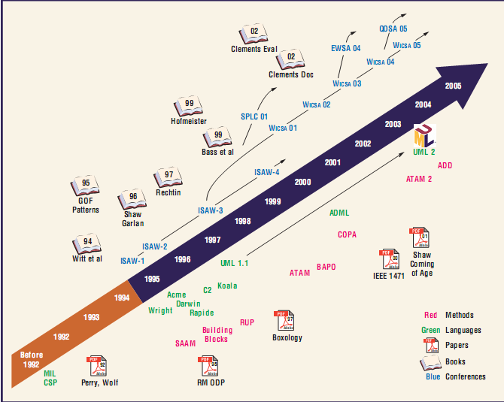

Slide 11
System Qualities Are Mainly Determined By Architectures
A given functionality can be achieved by many different architectures, with different qualities.
Quality requirements depend on the system architecture more than on the functional requirements.
Notes:
排序算法；CS vs BS

Slide 12
Too Often, Functionality Overrides Quality
“Systems are frequently redesigned not because they are functionally deficient – the replacement are often functionally identical – but because they are difficult to maintain, port, or scale, or are too slow or have been compromised by network hackers.”
Notes:
小高层建筑加装电梯

Slide 13
Architectures Facilitates Communications Among Stakeholders
Architectures focus on higher level of abstraction, not technical details
Architectures describe systems from all views

Slide 14
Programmer Maturity Model
PMM 1: Not Bad Coder
PMM 2: Good at data structure & algorithm
PMM 3: Familiar with design patterns & anti-patterns
PMM 4: Proficient in architectures
PMM 5: Great Creators
Notes:
程序员的出路
等待养老的程序员
需求分析、领域专家
项目经理、产品经理
售前、售后技术支持
架构师
创业

Slide 15
Summary
SA originates as SE evolves
SA focus on higher level of system abstraction and system qualities, taming the complexity of an architecture
SA determines system qualities
SA documentation is the basis for review, and detailed design

